Slide 1
1

Slide 2
We all have mental health.
2
Mental health is about our feelings, our thinking, our emotions and our moods.

Slide 3
3
Everybody knows how to look after physical health…
…looking after our mental health is just as important.

Slide 4
4

Slide 5
We all have feelings that come and go everyday. These are small feelings.
5
grumpy
nervous
happy
sad

Slide 6
Big feelings are feelings that go on for a very long time and stop us doing what we want in life.
6
They can affect our mental health.

Slide 7
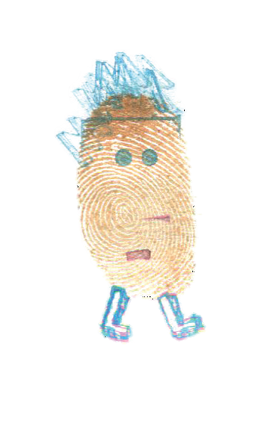
Who can help us?
7
teacher
parents
friend

Slide 8
8

Slide 9
How do you share your feelings?
9
I’ve got something to say

Slide 10
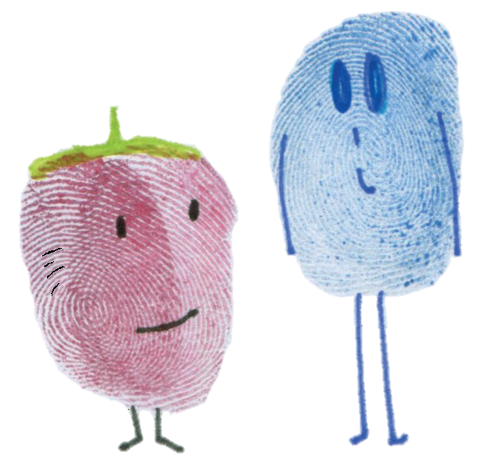
10
Do you have time to speak about something?

Slide 11
11
I have something important I would like to talk to you about…

Slide 12
12

Slide 13
13
sit side by side
make them feel comfortable

Slide 14
14
always listen carefully
help them find an adult if necessary

Slide 15
15
Remember if your feelings are getting too big to cope with on your own and you feel you want to change things…
…talking to someone you trust might really help.

